Slide 1
SEO Navigator: From Audit to Action
Presented by Shaik Arshiya Fathima

Slide 2
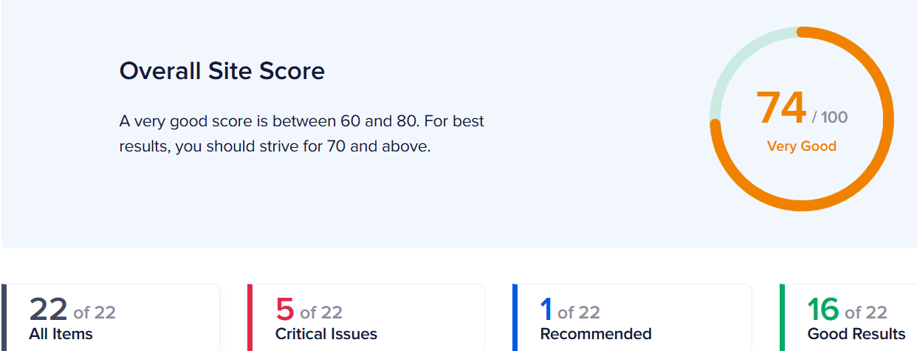
Initial Audit
SEO Performance Overview :- An analysis conducted three months ago assigned the site an SEO score of 71 out of 100, which is slightly below the average score of 74%. This indicates a solid foundation with room for enhancement.
SWOT Analysis from an SEO perspective :-
Strengths: Effective use of meta titles and descriptions; robust social media integration.
Weaknesses: Suboptimal URL structures; inadequate keyword optimization; lack of structured data; image optimization issues.
Opportunities: Implementing sitemaps and robots.txt files; integrating analytics tools; adopting modern image formats.
Threats: High number of HTTP requests; reliance on inline CSS.

Slide 3
Initial Audit
SWOT Analysis :- Strengths :
Strengths :
Strong brand recognition
Comprehensive product portfolio
Subscription-based model
Continuous innovation
Large and diverse customer base
Global presence
Weakness :
High prices
Competition from free or low cost alternatives
The complexity of software
Dependence on the creative industry
Resistance to change
Potential integration challenges
Cybersecurity risks
Opportunities :
Expansion into emerging markets
Targeting new customer segments
Strengthening the mobile eco -system
Leveraging artificial intelligence and machine learning
Expanding partnerships and collaborations
Focusing on vertical-specific solutions
Threats:
Increasing competition
Rapid technological advancements
Price sensitivity
Cyber security threats
Regulatory changes
Economic downtowns

Slide 4
Keyword Research
I have selected two products from the company called “Adobe”. The products are, Acrobat AI Assistant and Acrobat Sign.
Acrobat AI Assistant Keywords:
ai assistant for acrobat - Informational (The user wants to find an answer to a specific question)
adobe acrobat ai assistant - Navigational (The user wants to find a specific page or site)
acrobat ai assistant - Navigational (The user wants to find a specific page or site)
adobe ai assistant acrobat - Navigational (The user wants to find a specific page or site)
ai assistant acrobat​ - Navigational (The user wants to find a specific page or site)
adobe acrobat turn off ai assistant - (The user wants to find an answer to a specific question)
ai assistant adobe acrobat - Navigational (The user wants to find a specific page or site)
acrobat ai assistant free
acrobat ai assistant not showing
acrobat disable ai assistant

Slide 5
Keyword Research
Acrobat Sign Keywords:
adobe acrobat sign in - Navigational,Transactional(The user wants to complete an action (conversion))
adobe acrobat sign - Navigational,Transactional(The user wants to complete an action (conversion))
acrobat sign - Navigational,Transactional(The user wants to complete an action (conversion))
signing in adobe acrobat - Navigational,Transactional(The user wants to complete an action (conversion))
acrobat adobe sign in - Navigational,Transactional(The user wants to complete an action (conversion))
adobe acrobat sign login​ - Navigational,Transactional(The user wants to complete an action (conversion))
sign in adobe acrobat - Navigational,Transactional(The user wants to complete an action (conversion))​
sign in to adobe acrobat - Navigational,Transactional(The user wants to complete an action (conversion))
adobe acrobat pro sign in - Navigational,Transactional(The user wants to complete an action (conversion))
can i get sign for already signed acrobat - (The user wants to find an answer to a specific question)

Slide 6
Technical SEO
1. Acrobat Sign for Business
Key Technical Issues:
JavaScript-Heavy Content: The page relies on JavaScript for rendering key elements, which may hinder search engine crawlers from accessing all content.​
Video Embeds: Multiple embedded videos can increase page load times if not optimized properly.​Yahoo Developer Network
Lack of Structured Data: The absence of structured data (e.g., JSON-LD) means search engines may not fully understand the page's content hierarchy.​
Recommendations:
Implement Server-Side Rendering (SSR): Ensure that essential content is rendered on the server side to improve crawlability.​
Optimize Video Loading: Use lazy loading for videos and consider providing static thumbnails to reduce initial load times.​
Add Structured Data: Incorporate schema markup to enhance search engine understanding and improve rich snippet visibility.

Slide 7
Technical SEO
2. Acrobat AI Assistant
Key Technical Issues:
Dynamic Content Loading: Some content loads dynamically, which might not be immediately accessible to search engines.​
Image Optimization: High-resolution images without proper compression can slow down page loading.​Reddit
Missing Alt Attributes: Some images lack descriptive alt text, affecting accessibility and SEO.​
Recommendations:
Ensure Crawlable Content: Use techniques like SSR or dynamic rendering to make dynamically loaded content accessible to crawlers.​
Compress Images: Implement image compression techniques to reduce file sizes without compromising quality.​
Add Descriptive Alt Text: Provide meaningful alt attributes for all images to enhance accessibility and SEO.

Slide 8
Content Strategy Plan
1. Acrobat AI Assistant Content Goals
Educate users on features and uses of the AI Assistant​
Address troubleshooting and usability queries
Improve discoverability through informational and navigational intent targeting
Blog/Support Content Ideas
"How to Use the Adobe Acrobat AI Assistant to Boost Productivity"
"Troubleshooting the Acrobat AI Assistant: Fix Visibility & Access Issues".​
"Is Acrobat AI Assistant Free? Understanding Access & Pricing"
"How to Disable the AI Assistant in Adobe Acrobat"
Content Formats
Short videos: "3 Things You Can Do with Acrobat AI Assistant"
Infographics: Feature comparisons of Adobe AI tools
FAQs section: Directly embedded on product pages to address common questions

Slide 9
Content Strategy Plan
2. Acrobat Sign Content Goals
Guide users through the login/signing process
Drive conversions through targeted support and how-to content
Educate users on the benefits and use of Adobe Sign for businesses
Blog/Support Content Ideas
"How to Sign Into Adobe Acrobat Sign: A Step-by-Step Guide"
"What Can You Do With Adobe Acrobat Sign?"
"Already Signed a Document in Acrobat? Here’s How to Add Another Signature"
"Adobe Acrobat Sign vs. Traditional Signatures: What's Best for You?"
Content Formats
Demo videos: “Signing a PDF in 60 seconds”
Interactive How-To Guides
Webinar or Case Study: Featuring how businesses are using Adobe Sign

Slide 10
Recommendations Document
1. On-Page SEO Optimization
Area | Findings | Recommendations
Title & Meta Tags | Optimized but can be further enhanced for CTR | Add emotional triggers and CTAs; keep under optimal character limits
Keyword Placement | Keywords are partially used in headings and content | Integrate primary + secondary keywords naturally in H1, H2, first paragraph
HTML Structure | Good hierarchy but could be streamlined | Use only one H1 per page; clearly nest H2s/H3s to reflect logical topic grouping
Internal Linking | Present but inconsistent across support/content | Add contextual internal links from FAQs/blogs to key product and pricing pages
Image Optimization | Some images lack descriptive alt text; large file sizes | Add missing alt text, compress images, rename files with keyword relevance

Slide 11
Recommendations Document
2. Technical SEO Enhancements
Issue | Status | Recommendations
JavaScript-heavy rendering | Impacts crawler visibility | Use SSR or dynamic rendering for JS-rich sections
Image/video load time | Slows down mobile performance | Lazy load videos and large images; defer offscreen resources
Structured data | Minimal to none | Add FAQ, HowTo, and Product schema to improve SERP visibility
Mobile responsiveness | Generally good | Avoid cumulative layout shifts (CLS) by stabilizing mobile UI elements
Sitemap/robots.txt | Likely in place, not optimized | Ensure sitemap is updated and robots.txt allows crawling of JS/CSS and key resources

Slide 12
Recommendations Document
3. Content Strategy Recommendations
Focus Area | Recommendations
Keyword Intent Mapping | Target high-volume informational and transactional keywords with mapped content
Blog Expansion | Launch blog posts for troubleshooting, comparisons, use cases, and tutorials
Multimedia Content | Add short how-to videos, interactive demos, and infographics to diversify content
Topical Authority | Build long-form guides and clusters around “AI Assistant” and “PDF Signatures”
User FAQs | Address trending searches (e.g. “disable AI Assistant,” “Sign not showing”)

Slide 13
Recommendations Document
4. Performance & Speed Optimization
Best Practices | Execution Suggestions
Minify CSS/JS | Remove unused code with tools like PurifyCSS or Tree-shaking
Lazy Load Content | Especially for below-the-fold images and videos
Use CDN and Caching | Leverage a global CDN (Adobe likely uses one) and enable browser caching
Optimize Fonts | Serve fonts in WOFF2, preload key fonts
Compress Assets | Use WebP for images and gzip/Brotli compression for scripts

Slide 14
Recommendations Document
5. Link Building & Authority
Link Strategy | Suggestions
PR and Thought Leadership | Publish AI innovation stories on tech media and get authoritative backlinks
Guest Content Partnerships | Collaborate with SaaS, productivity, or developer sites
Industry Case Studies | Create case studies with featured clients and distribute them externally
Content Syndication | Syndicate blogs on Medium, Dev.to, and partner blogs
Community Engagement | Promote content in Adobe forums, Reddit, LinkedIn, and product-specific spaces

Slide 15
Recommendations Document
6. Tracking and Analytics
Recommended Tracking | Purpose
Google Search Console | Monitor keyword rankings, crawl issues, click-through rates
Google Analytics 4 | Measure conversion paths, time on page, exit rates
Heatmaps (Hotjar/Clarity) | Understand user behavior on long product pages
UTM-tagged Links | Track campaign effectiveness for content/blog promotion
Custom Dashboards | Create SEO dashboards to monitor progress weekly/monthly

